Slide 1
Differentiated Instruction
Focus on Family Studies
Presenters:
Catherine Long& Karen Atwal

Slide 2
Differentiated Learning is:
Focus on the individual learner
Responding to a variety of learning experiences
Awareness to take deliberate action to meet the needs of all learners

Slide 3
Differentiated instruction involves:
Using assessment to gather information about students’ readiness, interests and learning preferences
Using this information to differentiate the learning environment, instruction, and assessment and evaluation
Selecting from a varied repertoire of strategies to meet the particular needs of students
From:http://www.edugains.ca/resourcesDI/Brochures/DIBrochureOct08.pdf p.8

Slide 4
DI Principles
Differences in how students learn have a significant impact on achievement
Learning begins from a student’s point of readiness
A safe, non-threatening and respectful environment is vital
Essential concepts can be effectively presented in a variety of forms
from:
http://www.edugains.ca/resourcesDI/Brochures/DIBrochureOct08.pdf

Slide 5
“ Differentiation is an organized yet
flexible way of proactively adjusting
teaching and learning to meet kids
where they are and help them to
achieve maximum growth as learners.”
Carol Ann Tomlinson, 1999

Slide 6
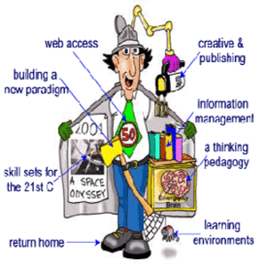
Challenges:
Time
Energy
Support

Slide 7
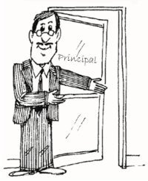
Overcoming Challenges
Planning
Organization
Sharing of resources
Support

Slide 8
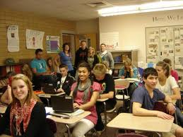

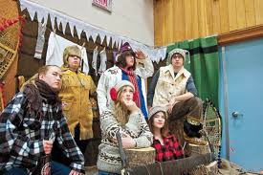
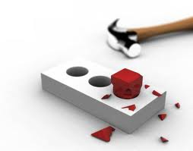
What we know:
Our students have different styles
Square pegs do not fit in round holes

Slide 9
Knowing the Learner
Take the time to make connections with students
Multiple Intelligences - (H.Gardner)
True Colours - (Meyers Briggs)

Slide 10
DI means DI doesn’t mean
Flexible, short-term groupings that allow students to work with a variety of peers with the same or different strengths and interests
Engaging and interesting tasks (that address the same skills) for all learning preferences, interests and levels of readiness
A reasonable number of well-constructed choices that address identified needs/strengths of students
Students working on the same curriculum expectations in various ways with common criteria for success
Students learning about themselves to help hem make effective and informed choices
Routines, procedures, and classroom agreements are in place
Labeling students or grouping by ability
Confining some students to low level, repetitive or rote tasks while others engage in higher-order thinking
Unlimited freedom for a student to choose whatever they would like to do on any day
Different students working on different expectations with varying success criteria (e.g., different rubrics)
Teachers assuming the responsibility for making all decisions regarding student choice
A chaotic or unstructured classroom environment,.
From: Student Success Differentiated Instruction Educators ‘s Package (2010) p.4

Slide 11
DI in Family Studies:
DI in Family Studies Means: | DI Doesn’t Mean
Developing a plan for rotating groups in food and sewing labs Theory and practical are key components in all Family Studies Courses Design a living space by; build a model, create a floor plan on paper or in a designate space Create characters for a dating site or plan a wedding agenda for THEORIES OF ATTRACTION AND MATE SELECTION Safety standards for sewing/ food labs | It doesn’t mean having one student name the baby and the other student change the baby It doesn’t mean grouping academic students and applied level students separately It doesn’t mean students will cook or sew every day It doesn’t mean some students make cookies while other make creme brule It doesn’t mean offering only one “good “ option for the practical sewing culminating

Slide 12
What we need to know:
Know the learner
Know the curriculum expectations
Applications of DI for Family Studies

Slide 13
The Key Features in the Family Studies Classroom
Choice
Respectful task based on curriculum
Flexible grouping
Shared responsibility for learning
From: Student Success Differentiated Instruction Educator’s Package (2010)p.

Slide 14
Choice
Providing choices in activities such as:
    HPC30 Parenting- Representation of a family
      Photo/Magazine collage
      Written descriptions
      Artwork/Graffiti

Slide 15
Tasks Based on Curriculum
Graffiti - Food and Nutrition - HFN10
  Introducing/reviewing the Food Guide
  Write the name of a Food Group on each chart paper. Students move in groups from on paper to another adding information in any creative way
  Also great for test /quiz review
FROM: St. Joseph-Scollard Hall Secondary School Family Studies/Food and Nutrition Our Top 10 Strategies for Helping to Inform Differentiated Instruction:

Slide 16
Flexible grouping
Read your class / know your students
Group work and collaboration is very common in the family Studies classroom, especially for practical tasks
Being ever aware of group dynamics is often a challenge
Set clear standards for communication, respect, and inclusion at the beginning of the term
Be consistent - Inspect what you expect

Slide 17
Shared Responsibility for Learning
Students often tell us what they think we want to hear
They attempt to give us the ‘right’ answer
Contracts that the students help create can combine non-negotiable items and creative options that the student has a voice in

Slide 18

Key Note Speaker:
Michael Tudor- Personality Dimensions

Slide 19
Break out Sessions
These will be run in individual class setting by various teachers. Participants will take home a copy of all the resources and handouts that were used in the session. Each session will be a mock family studies class that teachers participate in. These lessons are all DI based and can be used in their own classrooms.
10:15-11:15 Breakout Session 1 or 2:
  Breakout Session 1: DI in Foods
  Breakout Session 2: DI in Fashion
11:15 – 12:15Breakout Session 3 or 4:
  Breakout Session 3: DI in Parenting Courses
  Breakout Session 4: DI in Families Course

