Slide 1
Garnish Galore

Slide 2
The Overall Idea of Garnishing
Food that tempts the eye is more likely to tempt the taste buds. When a meal is presented with flare, your guests are more likely to eat and enjoy it.

Slide 3
Garnish
The word garnish is derived from the French word “garnir” meaning to adorn or furnish
Classical garnish
  The terms garnish and garniture have been used to mean accompaniments. Classical garnishes range in complexity from:
    Concorde - peas, glazed carrots, mashed potatoes
    to
    Tortue - quenelles, mushroom heads, gherkins, garlic, tongue, calves’ brains, small fried eggs, heart-shaped croutons, crayfish, slices of truffles, Tortue sauce

Slide 4
Simple Plate Garnish
There is no one garnish that can be applied to all plates. There are two approaches from the point of view of garnishes.
  No garnish
  Simple decorative garnish
A garnish should fit the plate and the color scheme

Slide 5
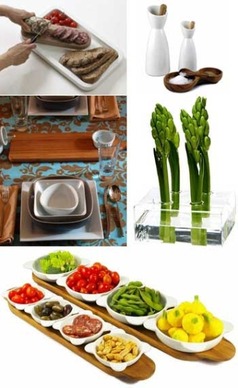
Simple Decorative Techniques
Cucumbers
Grapes
Mushroom caps
Fried parsley
Radishes
Scallion brushes
Pickle fans
Lemons
Frosted
Toast points
Quenelles
Ring molds

Slide 6
Modern Hot Platter Garnish
In classical cuisine, foods were almost always brought to the table on platters
Platter garnish does not need to be elaborate or difficult to prepare
A simple assortment of well cut vegetables cooked properly to retain flavor and texture is good
Many of the rules of proper plate garnish apply to platter garnish. Some additional guidelines are:
  Vegetables should be in easily served units
  Have the correct number of portions of each item
  Arrange the garnish around the platter for effect
  Avoid being too elaborate
  Serve extra sauce or gravy in a sauceboat
  Serve hot food hot, on a hot platter

Slide 7
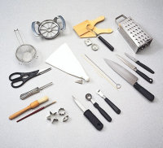
Tools of the Garnish Trade

Slide 8
Garnishing Tools
Just as you rely on the equipment in your kitchen to help you turn out a good meal, you'll also need a few tools to create spectacular garnishes.
Apple cutter/corer
This wheel- shaped gadget is great for cutting vegetables, such as carrots, as well as apples.
Brushes
Standard pastry brushes work for most garnishing, but for precise or delicate chores, a child's small paintbrush is best.

Slide 9
Butter curler, butter paddles and candy molds
Each of these helps you shape butter. Use the curler to form delicate butter curls, the paddles for butter balls and the molds for special designs. Candy molds are also known as butter molds.
Citrus stripper
Use this tool to cut a thin strip of peel from citrus fruit or other fresh produce.
Decorating bag
Use these items for piping designs and other cake- decorating tasks. The decorating bag is also known as a parchment cone.
cular garnishes.

Slide 10
Decorating tips
The tips you'll use most often are writing tips, star tips, rose tips, and leaf tips. Start out by purchasing one of each type. Then add to your collection whenever you need an additional tip for a new garnish.
Grapefruit knife
The jagged edges on this knife come in handy for many garnishing tasks.
Hand grater
A grater with at least one section for fine pieces and another section for larger shreds is the most practical.

Slide 11
Small cookie cutters
These are sold in most cookware shops. Choose the shapes you think you'll use most often. Small cookie cutters are also known as hors d'oeuvre cutters.
Knives
Sharp knives are a must. The knives you'll use most often are a chef's knife for cutting large items, such as watermelons; a utility knife for medium-sized foods, such as pineapples or cantaloupes; and a paring knife for all-purpose cutting.
Melon baller
This handy tool comes in a variety of sizes. The one that is the most versatile is the 1-inch-diameter size.
Scissors
A small pair is ideal for snipping small items, such as green onion tops. Kitchen scissors or poultry shears are better for large, tough jobs.

Slide 12
Skewers and toothpicks
For garnishing, keep a supply of wooden toothpicks, as well as 6- and 10-inch wooden skewers, on hand. Occasionally you may need a metal skewer. Choose one about 8 inches long.
Vegetable peeler
The swivel- type of peeler works best. Just make sure it's sharp.
Wire strainer
This bowl-shaped tool made from wire mesh is great for sifting or sprinkling powdered sugar or cocoa over foods, as well as for draining foods. Wire strainers are also known as sieves.

Slide 13
Tips for Bright, Colourful Garnishes
Once cut, some foods discolor quickly, e.g. pears, apples, bananas, avocados, potatoes and eggplant. To slow the discoloration process down, brush the cut surfaces with lemon juice before wrapping and refrigerating.

Slide 14
How to Make Garnishes Last
To maintain and heighten the color of fresh vegetables, blanch them before using them to make garnishes. Simply immerse the produce in boiling water for 1 minute, drain, and plunge into a large bowl filled with ice water or rinse quickly under very cold running water. Always dry the ingredients thoroughly before use.
To prevent drying out, keep garnishes away from air and heat. If possible, protect them with an airtight covering of plastic wrap.
It's always best to make garnishes just before serving, but some can be prepared ahead of time and assembled on the plate at the last minute.

Slide 15
Store garnishes like you would similar foods. If made with ingredients that are normally refrigerated, wrap in plastic wrap, or store in an airtight bag or container, and refrigerate.
If the ingredients are crispy or dried, or if they need to firm up, do not refrigerate. Store in a cool, dry place for several hours or overnight.
Some cut-up or carved vegetables can be prepared in advance and covered with ice water until you are ready to assemble the finished presentation. Be sure to drain and dry them off well before placing the garnishes on the plate.
Add garnishes to the food just before serving.

Slide 16
In Conclusion
Garnishes are essentially the “cherry on top”, completing the picture that has been created by the chef.
A simple garnish is often all that is required to finish a dish but it must be cohesive in appearance and flavour, complimenting the dish – not standing apart from it.

